Slide 1
Sound Energy Grab the sheet from the desk. Brainstorm everything you currently know about sound. Be ready to share.
Write in your agenda: Sound Quiz next Wednesday

Slide 2
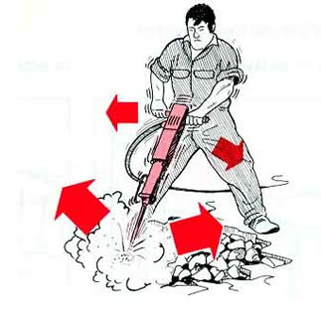
Sound Vibration
WHAT IS SOUND?!?!?
Is a wave that vibrates particles of matter
A rapid back and forth movement

Slide 3
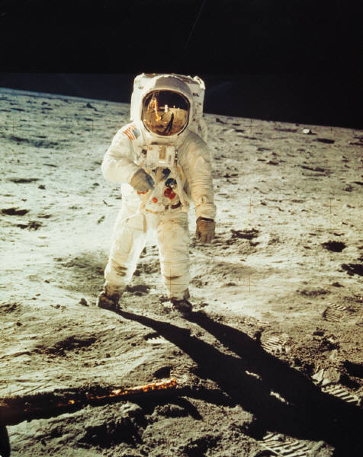
IS THERE SOUND IN SPACE?
Space is a vacuum, which means empty space or very few particles.
Vibrations have to travel through matter in order to make a sound. (mechanical wave)
In space there is no ‘air’ or medium for the wave to vibrate, thus no sound can be produced.
Notes:
Mechanical wave

Slide 4
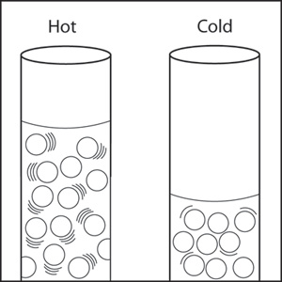
What Affects the Speed of Sound?
Temperature and the medium effects the speed of sound.

Slide 5
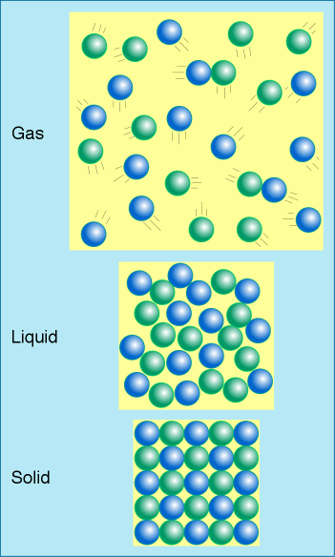
Speed of Sound in Different Mediums
In order for particles to vibrate in a wave, one particle must then hit the next particle to pass on the energy and continue the wave. There is not as much space between particles in a solid so the vibration wave would move faster. In a gas there is a lot more space in between so the particle would take longer to hit the next.
Think of it like the spacing of dominoes

Slide 6
How Sound Travels
Speed of sound is affected by material:
Solids- fastest
Gases – slowest
Speed of sound is affected by temperature:
Higher temp. – faster
Lower temp. - slower

Slide 7
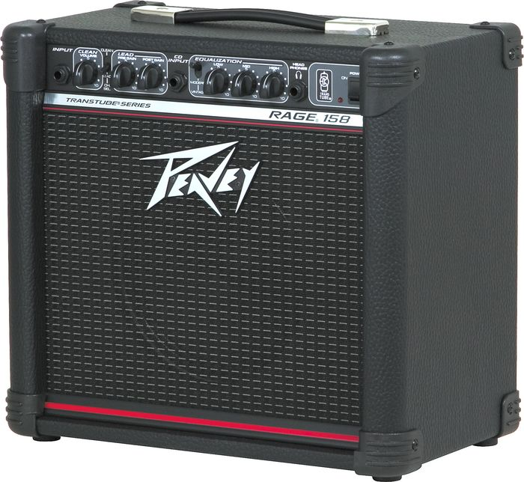
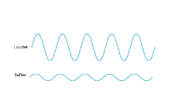
Amplitude/Intensity/Volume
Amplitude determines intensity, which is just how loud/soft sound is.
High amplitude = high intensity=high energy = loud
Low amplitude = low intensity = low energy = soft

Slide 8
Loudness of Sound in Decibels
Decibels (dB) = measure of intensity or loudness
Sound | Loudness (dBs) | Hearing Damage
Average Home | 40-60
Loud Music | 90-100 | After long exposure
Rock Concert | 115-120 | Progressive
Jet Engine | 120-170 | Pain

Slide 9
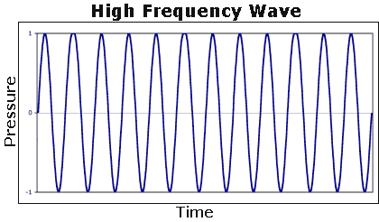
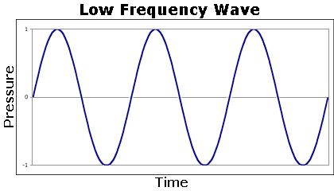
Pitch
High Pitch
Low Pitch
Pitch is determined by the frequency of the sound wave
Pitch is measured in Hertz (waves per second)
low frequency = low pitch, ex. rumble of a big truck
high frequency = high pitch, ex. whistle or siren
Fun Fact: women have higher frequencies than men.

Slide 10
How You Make Sounds
We use our vocal cords to make sounds in our throat.
When we speak, our vocal cords vibrate.
Place your hand on your throat when you talk, and you can feel the vocal cords vibrate.

Slide 11
ECHO! Sound Waves Reflect off of Surfaces!

Slide 12
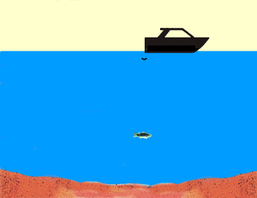
Sonar: A measuring instrument that sends out an acoustic pulse in water and measures distances in terms of the time for the echo of the pulse to return
Copyright © 2010 Ryan P. Murphy

Slide 13
Animals use sound waves to located prey items as well as navigate in echolocation.
Copyright © 2010 Ryan P. Murphy

Slide 14
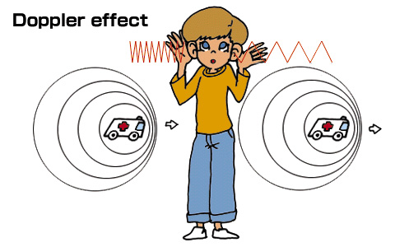
The Doppler Effect
The Doppler Effect is a change in the perceived pitch when the source of the noise is moving.
So to Further Explain: All waves, light and sound, travel out from the source, but when the source is moving towards you the waves get bunched closed together making a higher frequency/pitch and the waves trailing behind become spread out making a lower pitch/frequency.
http://www.youtube.com/watch?v=Kg9F5pN5tlI

Slide 15
Review Questions
What is sound?
Can sound travel through vacuum?
Why is sound a mechanical wave?
What are some of the factors that can affect the speed of sound?
Does sound travel at the same speed through different mediums?
Why does sound travel the fastest in solids?
Why does sound travel faster when the temperature is higher?

Slide 16
Review Questions
What is the Doppler effect?
How are frequency and pitch related?
What is SONAR?
What is echolocation?

Slide 17
http://studyjams.scholastic.com/studyjams/jams/science/energy-light-sound/sound.htm
http://onlinetonegenerator.com/hearingtest.html
http://www.noiseaddicts.com/2009/03/can-you-hear-this-hearing-test/
https://www.youtube.com/watch?v=sZHWY1KBHwc

Slide 18
Today we will be watching Bill Nye: Sound.
Please grab the sheet from the front and write your name on it.
Fill out the ABC’s on what you already knew and what you learned during this subunit.
http://www.schooltube.com/video/a46f21f6bf2346f792ab/Bill%20Nye%20-%20Sound

Slide 19
Today we will be reading Max Axiom: Sound as a reading group. Choose your groups wisely or they will be chosen for you. Go ahead and sit with your group. I need 6 groups so split yourselves evenly. Minimum of 2 maximum of 4 people per group.

Slide 20
Today we will be conducting the sound lab. You will need a pencil and your science notebook (or a piece of paper to put in your science notebook later).
There are 9 stations so groups of 2-3 at each station.
Please be gentle with the lab equipment.
Follow the instructions on the index card for each station.

Slide 21
Comparing Sound and Light Activity – you will need colored pencils and the sheet from the desk. Write your name on it.
Brainstorm on one side of the paper:
List 3 ways sound and light are alike:
1.
2.
3.
List 3 ways sound and light are different:
1.
2.
3.

Slide 22
Get your study guide from the desk and begin answering questions. We will be doing a scavenger hunt soon to find the answers! Put a star next to the ones you do not know.
Test on Friday! Study Guide on website
Topics: Sound, Light, Electromagnetic Spectrum

Slide 23
Test tomorrow – sound, light, electromagnetic spectrum, waves in general
Please grab the sheet from the front and answer the questions you can. After about 10 minutes, we will go on a scavenger hunt around the room to check the answers and get the answers you could not figure out.

Slide 24
Test today! Set up your forts!
Clear everything off your desk
You need a number two pencil because we will use a scantron

