Slide 1
You need a pen for today.
Think-Pair-Share on why soil is the next unit after rocks. How are they related?

Slide 2
Characteristics of Soil
Grab the blank paper from the front. You will also need colored pencils and scissors. With your table discuss “What is soil?”

Slide 3
Fold Paper hot dog style but not all the way to the edge. Leave about 1 inch for the title. The title is Soil Profile Foldable
You need 5 flaps so make 4 cuts. Make the first flap a little smaller than the rest, and the 4th flap a little larger.
Flaps are to represent each soil horizon. Label each on the front.
O Horizon: Surface Top of foldable
A Horizon: Topsoil
B Horizon: Subsoil
C Horizon: Parent Material
R Horizon: Bedrock Bottom of foldable.

Slide 4
Color the outside of the foldable to represent each horizon.
Inside the flaps need to say the name of the horizon, the color of the horizon, and the horizons composition and properties

Slide 5
WHAT IS SOIL?
Soil forms as rock is broken down by weathering and mixes with other materials (decaying plant and animal matter) on the surface.

Slide 6
Where is soil located?
The upper-most layer of the continental crust is covered by soil

Slide 7
What is a soil horizon?
-Horizon is a side profile of the layers of soil
-Soil is usually divided into 3 main layers, but will also include the layers above and below for a total of 5 layers.

Slide 8
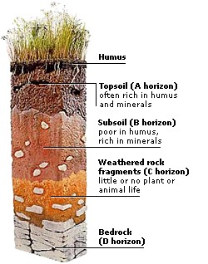
What are the soil horizons??

Slide 9
What is the O Horizon (litter)?
-Not really a layer of soil
-It’s on top of the first layer of soil
-Contains grass, plants, and animals

Slide 10
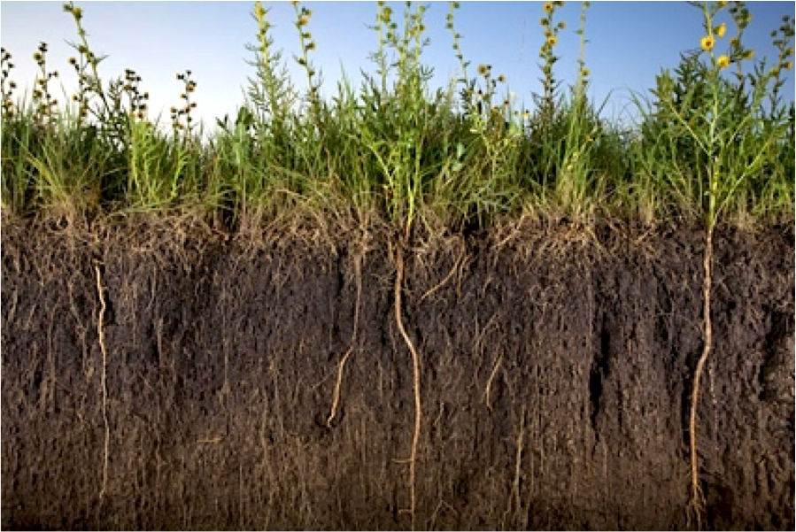
What is the A Horizon (topsoil)?
-First layer of soil
-Darkest layer of soil
-Contains humus, plant roots, small animals, water, and nutrients for plant growth
-The darker the soil, the more nutrients it contains

Slide 11
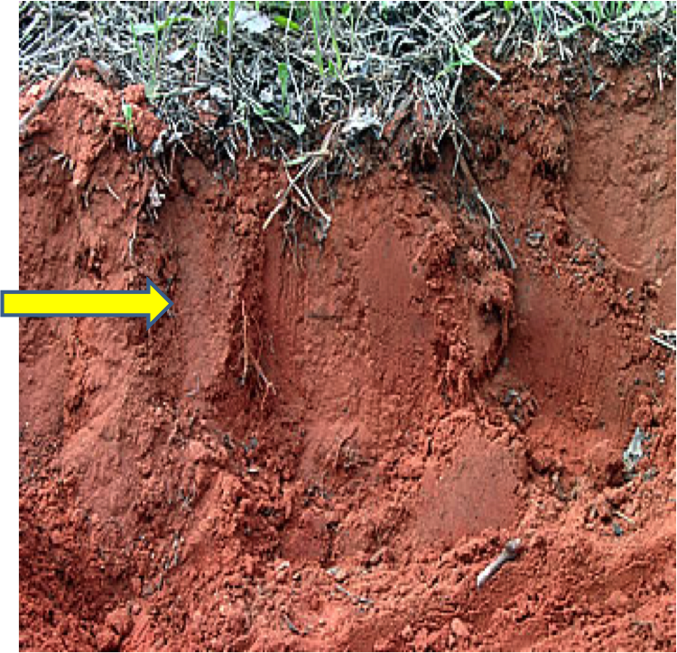
What is the B Horizon (subsoil)?
-Second layer of soil
-Lighter in color (reddish brown)
-Fewer nutrients and water
-Limited plant growth

Slide 12
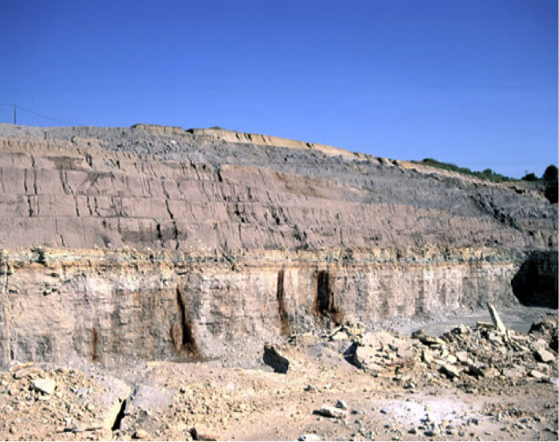
What is the C Horizon (parent material)?
-Third layer of soil
-Lightest in color (gray)
-No nutrients, animals, or plant growth
-Contains weathered rock and sediment

Slide 13
What is the R Horizon (bedrock)?
-Below the last layer of soil
-Solid Rock
-Has not been weathered or broken down yet
-No soil in this layer

Slide 14
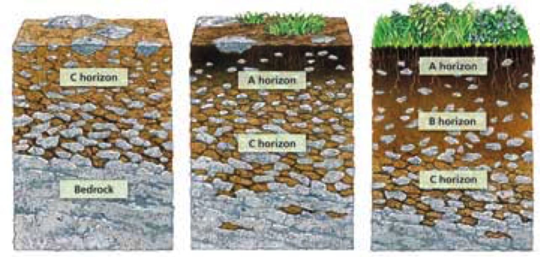
How is soil formed?
-From the weathering (breaking down) of rocks.
-Warm and wet climates, soil forms fastest
-Cold and dry climates, soil forms the slowest

Slide 15
What creates the layers?
the composition and texture of soil and its fertility and resistance to erosion are greatly influenced by plant roots and debris, bacteria, fungi, worms, insects, rodents, and other organisms (organic matter)

Slide 16
Is soil all the same?
The ingredients in soils can vary from place to place and around the Earth.
Different soils have many properties
Depending upon the combination of properties, soils have great variability in their ability to support structures and plant growth.

Slide 17
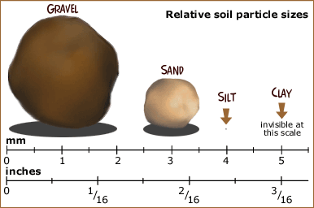
What are the characteristics of soil?
-Texture-what the soil feels like
-Particle Size (see picture)
-pH-acidity in the soil
-Permeability – how easily water flows through it
-Viability-nutrients in the soil (nitrogen, phosphorus, etc).

Slide 18
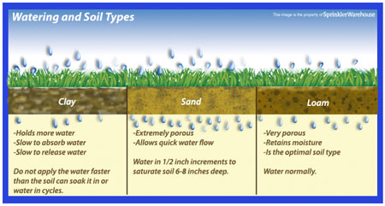

Slide 19
https://www.brainpop.com/science/earthsystem/soil/

Slide 20
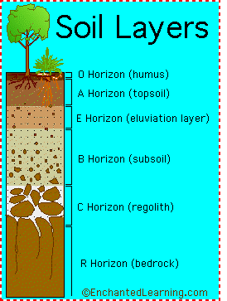

Slide 21
What is CURE?
C – Circle Main Idea (in each paragraph)
U- underline key details
R- respond in the margin (feelings, questions, connections)
E- examine vocabulary
You context clues to figure out words you do not understand.

Slide 22
Core 2 Articles Find your name
What is Soil? | Properties of Soil | The Living Soil | Digging Up the Dirt
Belle | Anshu | Nolan | Marlie
Cooper | Ella | Lindsey H | Connor
Nicholas C | Matthew | Abigail | Caitlyn
Lakelyn | Dylan | Cameron C | Maya E
Xavier | Nikhil | Ethan | Thomas
Ryan | Nick F | Owen | Alec
Eleanor | Lindsey W | Nicole | Audrey
Mia | Maya S.D. | Celeste | Josie

Slide 23
Core 3 Articles – find your name
What is Soil? | Properties of Soil | The Living Soil | Digging Up the Dirt
Josh | Mariana | Maya B | Manish
Harry Grason | Jamirah | Sarah | Carter
Shane | Jordan | Katie | Jackson
Carl | Jemiyah | Marcos | Ava
Lia | Paul | Kate | Gabe Jonah
Elsie | Leo | Stone Brooke | Jacob

Slide 24
Core 4 Articles – find your name
What is Soil? | Properties of Soil | The Living Soil | Digging Up the Dirt
Trey | Jordy | Landon | Daniel
Brett | Donovan | Margot | Stasia
Sydney | Chuks | Ranvir | Riley
Brandon | Claire | Kira | Brenden
Bridget | Gabby | Sophia M | Sophia S
Christian | Lucas | Ishaan | Nicholas S
Semaya | Evan | Thea | Piper John

Slide 25
One Pager Guideline:
Appropriate Title (5 points)
Expresses main idea (20 points)
Fills entire page (10 points)
Uses two quotes from the article (5 points each)
Uses proper grammar / spelling (5 points)
At least three visual images (5 points each)
Use vocabulary words (5 points)
Write two questions and answer them (10 points each)
Make visually appealing (color) ( 5points)
Be purposeful with the arrangement ( 5 points)
Names on back

Slide 26
Get with your groups from Friday and finish your one-pager. You have the rest of today to finish.

Slide 27
Grab the lab sheet from the front and begin reading over it.
Be ready to ask any questions you may have.
Messy lab tomorrow – dress appropriately

Slide 28
Get out your lab sheet from yesterday. You will need it and a pencil.
Figure out your group of 3 or 4 and line up with them.

